Slide 1
Datawarehousing Concepts
Day -2

Slide 2
Agenda
Difference between DW and DM
Difference between ETL and ELT
Demand ETL Tools
Data Load Activity
Types of Facts
Types of Dimension
Slowly Changing Dimension
Star schema Vs Snowflake schema
Change Data Capture
Important Notes
Q & A

Slide 3
Datawarehouse Vs Data Marts
Parameters | DWH | DM
Size | More than 100 GB to TB | Less than 100 GB
Build Time | Months to Years | Months
Design | To built DW is difficult | Build a DM is easy
Subjects | Holds data from multiple subjects | Holds data from specific subjects
Characteristics | Flexible , Data orientation | Restrictive, Project orientation
Scope | Centralized | Department Specific
Data source | Data from Multiple Sources | Single Source mostly from warehouse
Data Perspective | Holds detailed information | Holds summarized information. Ex Subject specific and Dept Specific

Slide 4
ETL Vs ELT
Parameters | ETL | ELT
Abbrev | Extract Transform and Load | Extract Load and Transform
Tools | Informatica, Data Stage, Talend | Oracle Data Integration, Stich data, Skyvia
Usage | Authenticate DW platforms | Mostly used in Big Data platforms
Complexity | ETL is best suited for complex Transformations | ELT is best when dealing with massive amounts of structured and unstructured data
Data Loading | Data first Loads into staging then into Target | Data directly loads into Target
Cost | High cost | Low cost
Data Support | Mostly supports Structured Data | Supports Semi / Un structured datatype
Time Load | Time intensive (SRC → STG → TGT) | Data loaded into Target system only once . Faster

Slide 5
Demand ETL Tools 2021
ETL Tools Falls under 3 category
Open source
Talend Open studio for Data Integration
Pentaho Data Integration
Commercial
Informatica Data center
IBM Data stage
Hybrid
Talend (Combination of little bit free + Paid ones) → Enterprise Edition

Slide 6
Data Load Activity
E
T
L
T
O
O
L
E
T
L
T
O
O
L
E
T
L
T
O
O
L
Reporting
SRC
STG
BASE
Load Duration → Daily, Weekly, Monthly, Yearly (Depends on project)
Load Type:
Initial Load → Very first time loading the data into the table
Incremental Load → Subsequent Load after the very first Load

Slide 7
Types of Facts
There are 3 types of facts tables are there.
Additive Facts
All the aggregate functions can be applied on the data.
Example → Sales Amount ( We can apply Min, Max, Sum, Avg)
2) Semi Additive Facts
Can apply some aggregate functions but NOT all.
Example → Current_Account_Balance (We can apply Min , Max but we can’t apply Sum)
Non-Additive Facts
Can’t apply any aggregate functions on the data
Example → Percentage Discount (Applying Aggregate functions on the % doesn’t make sense)

Slide 8
Types of Dimensions
Dimensions | Definition
Confirmed | It shares across multiple subject area. (Ex: customer dimension, both marketing and sales department may use the same customer dimension table)
Degenerated | It’s not derived from dimension table. But it’s derived from the fact table. (Ex: Invoice number) “A fact table always stores Measures. Sometime fact stores dimension information”. Invoice number is not a measure. It basically an identifier and it supposed to be a dimension. But we most often see it ending up in fact table
Junk | If a model has too many small dimension, then we can put them together in a single dimension. (Ex gender, status attributes)
Role Playing | Same dimension which can be used for Multiple purpose. It would change the meaning when associated with fact tables ( Ex Date Dimension can be used for Date of Sale , Date of Hire
Static | Static dimension is something which never change over the period. It is always constant ( Ex Gender)
Slowly Changing dimension | Dimension which changes over period of time is a slowly changing dimension (Ex Address changes over a period of time for an individual and it might not be regular, but it changes over a period of time)

Slide 9
Slowly changing dimension
SCD Type | Definition
SCD 0 | Retaining Original Data ( Ex SSN, DOB)
SCD 1 | Truncate / Load approach → “Overwriting an Existing Data”
SCD 2 | Adding brand new records & Updating the Existing records “Keeping History”
SCD 3 | Insert/Update approach → Keeping only one previous history record and current Active record
SCD 4 | Adding a new table to track the history records
SCD 5 | Combination of SCD1 & SCD 4 ( It won’t be used in Real time)
SCD 6 | Hybrid Approach (SCD 1 & SCD2 & SCD3)

Slide 10
StarSchema Vs Snowflake Schema
Star Schema | Snowflake Schema
It contains a fact table surrounded by dimension tables | One fact table surrounded by dimension table which are in turn surrounded by dimension table
Simple DB Design | Complex DB Design
Denormalized | Normalized
Fewer joins | Multiple joins
Better Performance | Lower Performance
Require Smaller Disk Space | Require High Disk Space
Need Less maintenance | Need More maintenance
Required simple query process | Required complex query process

Slide 11
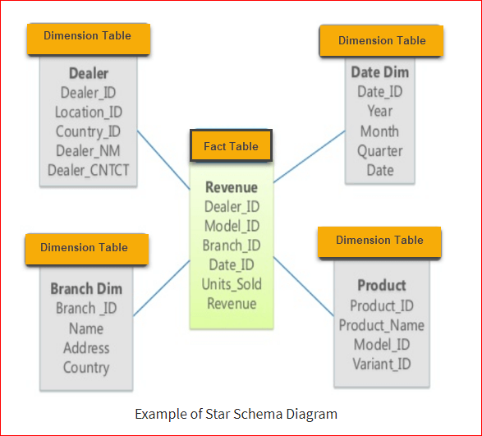

Slide 12
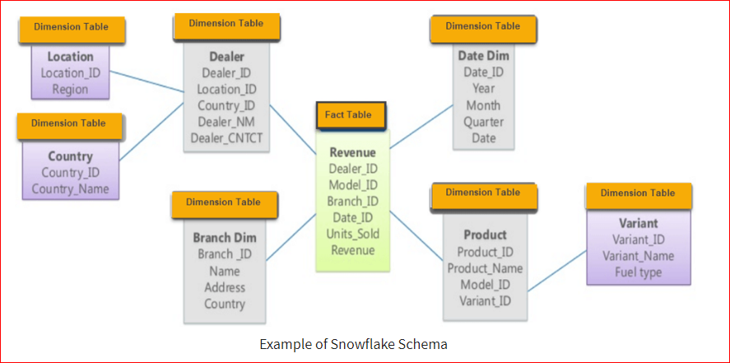

Slide 13
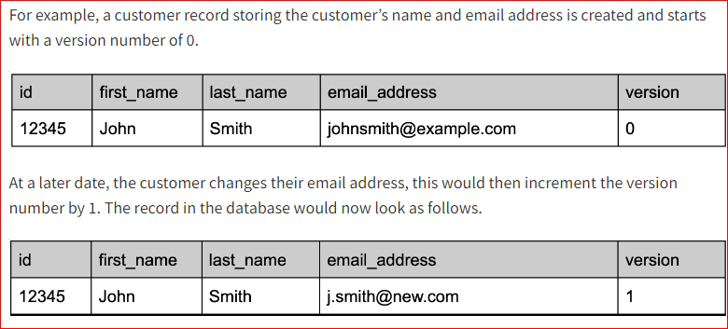
Change Data Capture (CDC)
Definition:
CDC is a process that captures changes made in a database and ensure those changes are replicated to a destination such as Datawarehouse
It records insert / Update & delete activity
Row Versioning

Slide 14
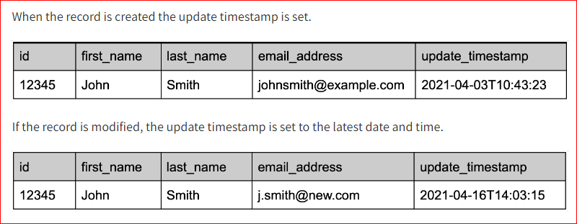
Change Data Capture (CDC)
Update Timestamps
The benefit of timestamps especially over row versioning is that the target system no longer has to keep a reference table. The target system can now just request any records from the source system that have an update timestamp greater than the latest one they have in their system

Slide 15
Important Notes
All the numeric are facts ? Yes (or) No
Can we connect two fact tables ?
Find what dimension / fact attributes ?
1) Gross amt
2) Customer Name
3) Salary amt
4) Net Amount
5) Transaction no
6) Invoice no
Which schema is complex one star (or) snowflake?
Can we have more than one fact tables in real time?
Do we have any specific tool for ELT?

Slide 16
